Slide 1
HOSPITAL MANAGEMENT SYSTEM

Slide 2
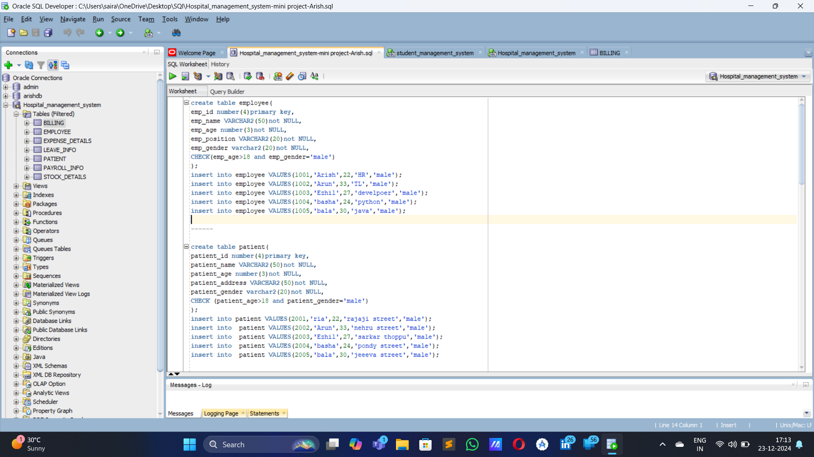
STEP 1:CREATE A DATABASE FOR HOSPITAL MANAGEMENT SYSTEM

Slide 3
STEP 2:CREATE A TABLE FOR EMPLOYEE

Slide 4
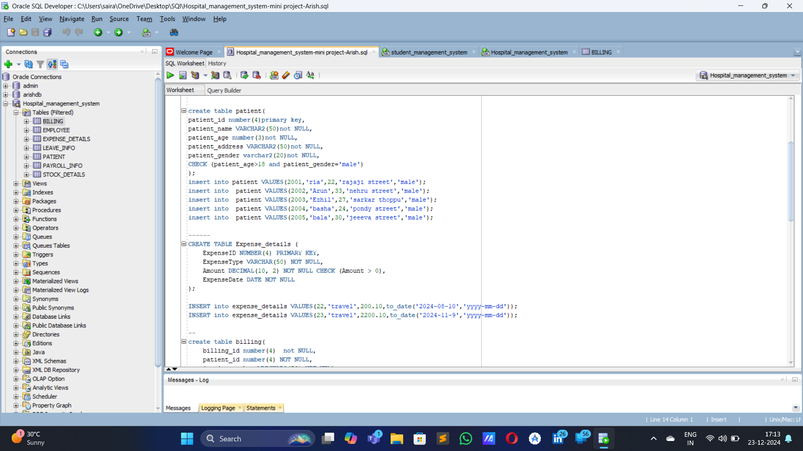
STEP 3:CREATE A TABLE FOR PATIENT

Slide 5
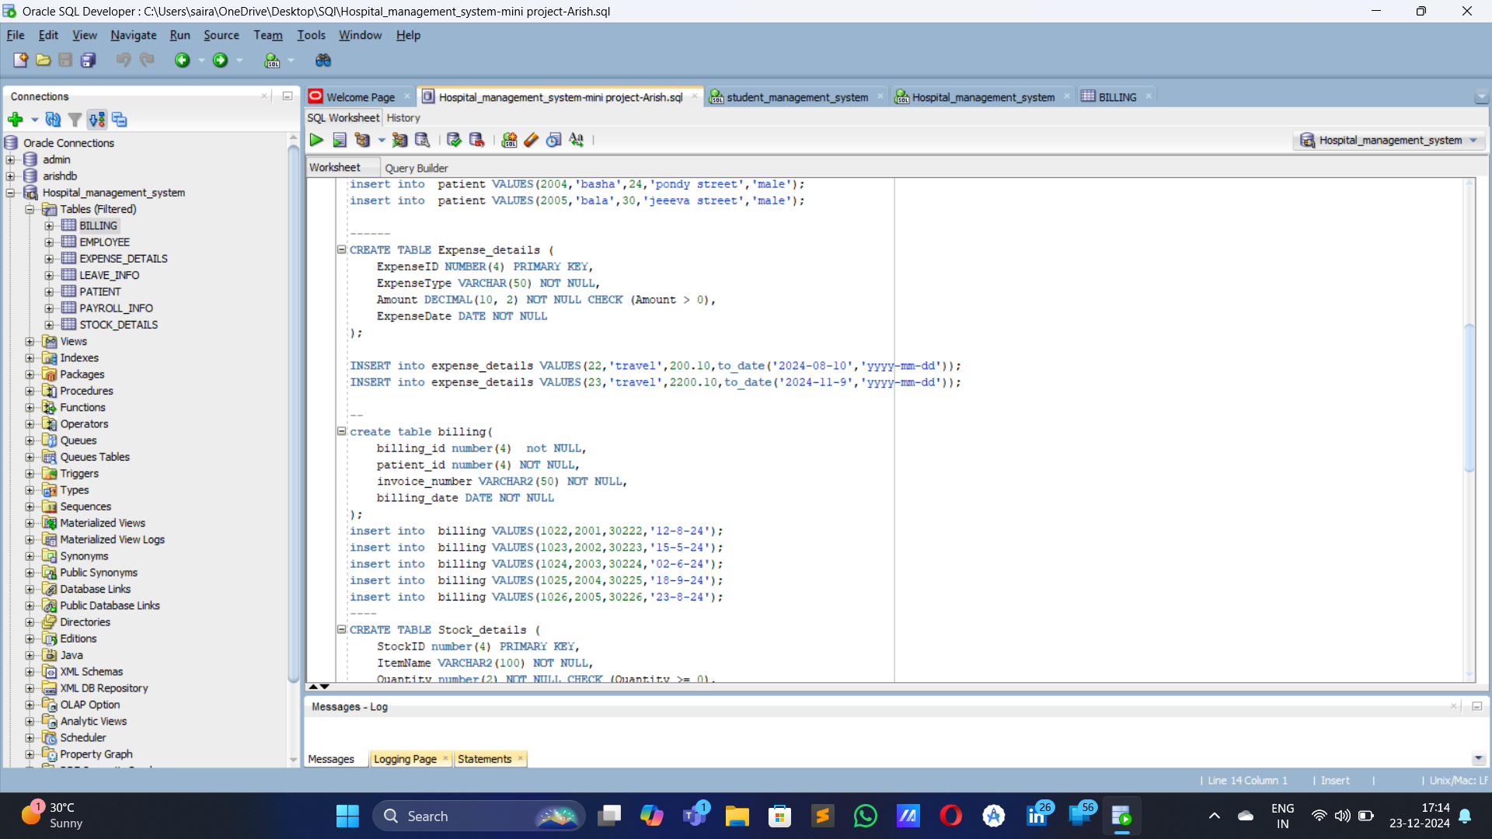
STEP 4:CREATE A TABLE FOR EXPENSE DETAILS

Slide 6
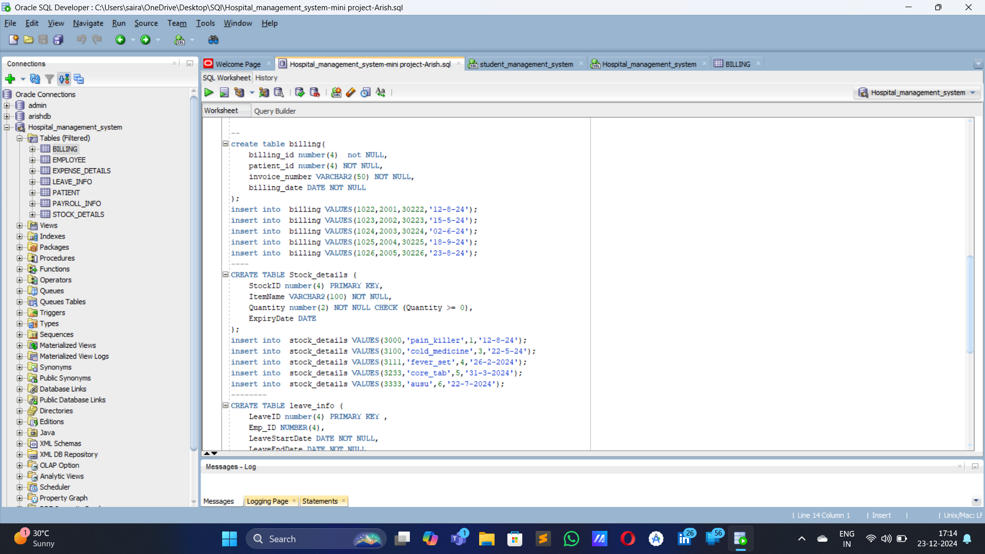
STEP 5:CREATE A TABLE FOR BILLING

Slide 7
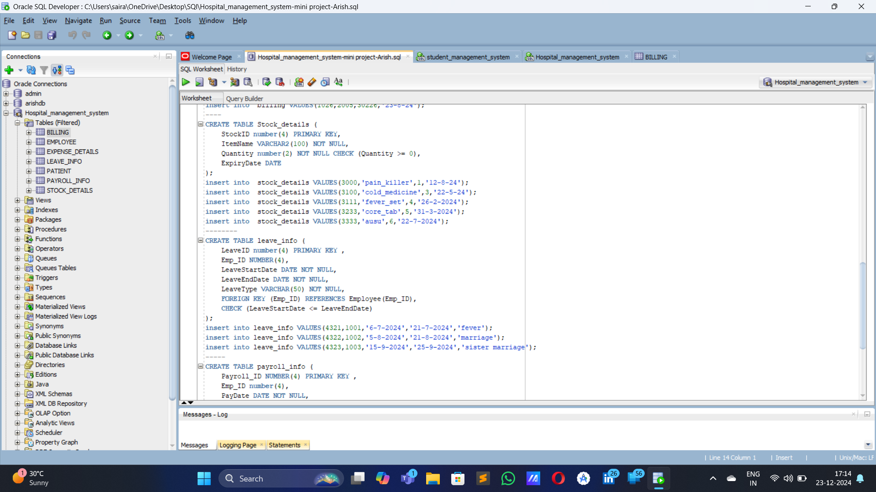
STEP 6:CREATE A TABLE FOR STOCK DETAILS

Slide 8
STEP 7:CREATE A TABLE FOR LEAVE INFO

Slide 9
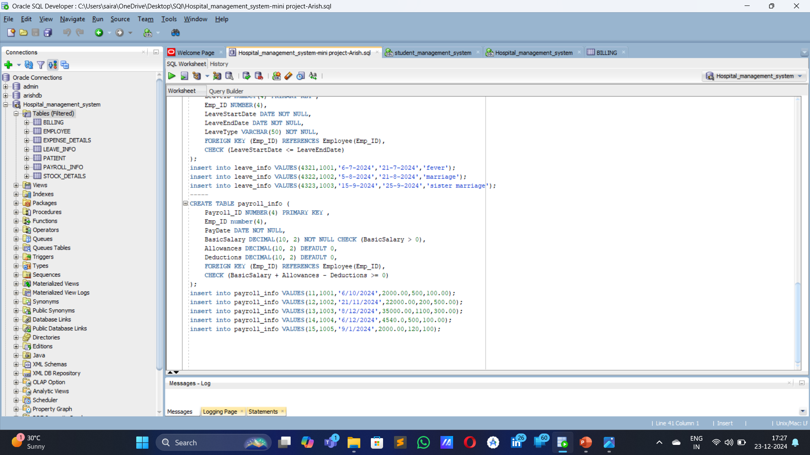
STEP 8: CREATE A TABLE FOR PAYROLL INFO

